Slide 1



Josh
Harwood
noworries.nz
@joshdesignnz
josh@noworries.nz

Slide 2
CONTENTS
Spark Design Tokens
Spark Homepage Personalisation
Spark Corporate Website Rebuild
Lightbox Dynamic Content
Spark Carrier Branding
COMING SOON
MATTR Design Process, UI Kit & Tokens

Slide 3

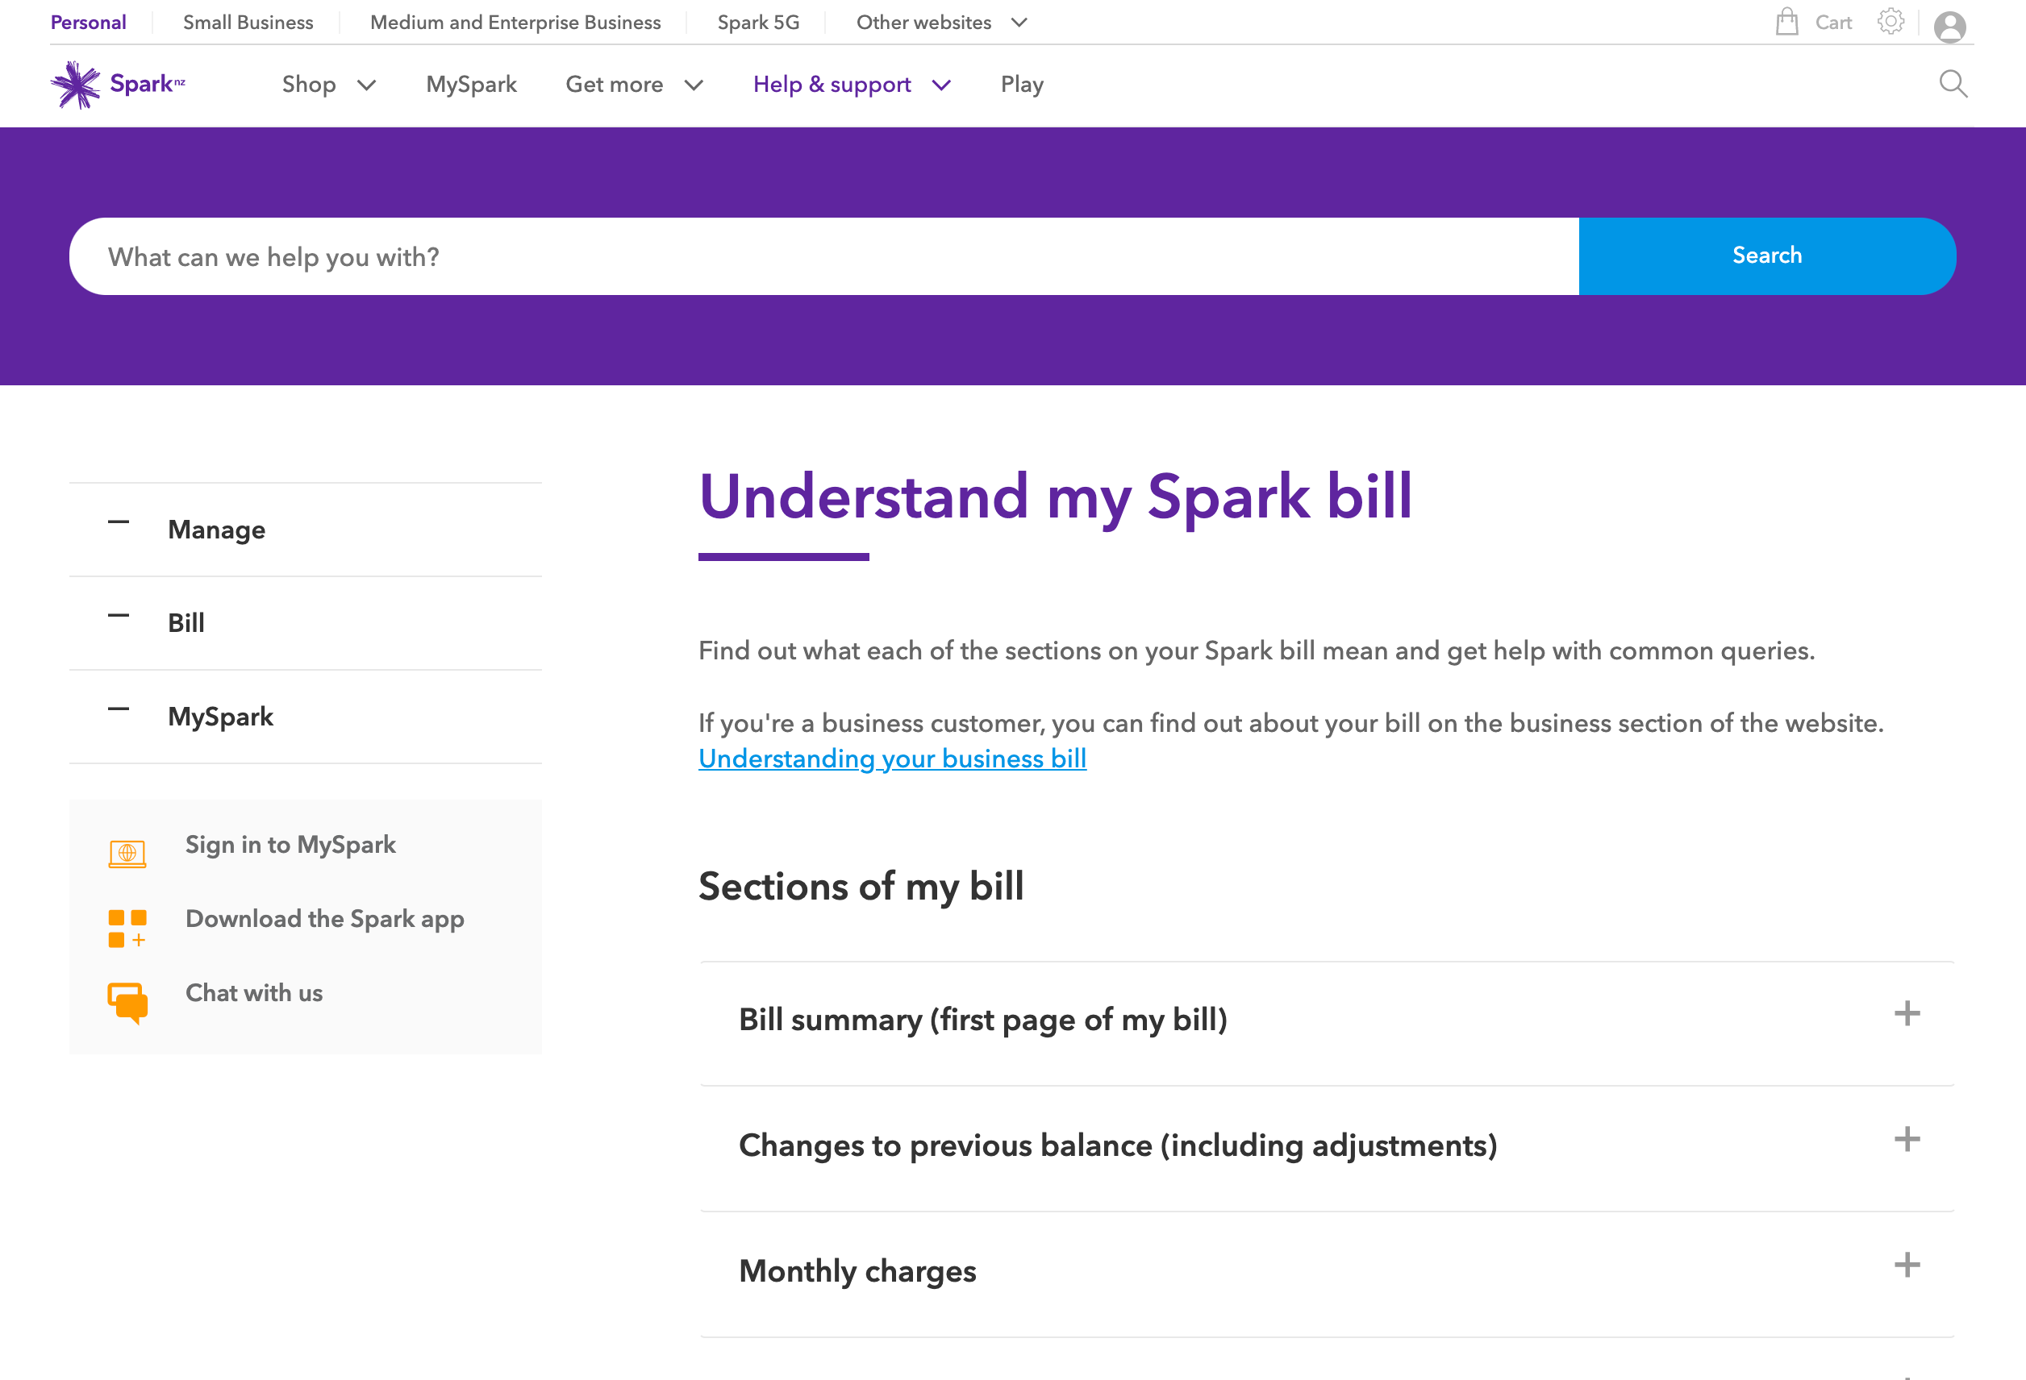
Spark
Design tokens
Background
There was a growing list of design debt (visual inconsistencies and issues) across the multiple Spark websites. Pages and components had inconsistent branding and styling issues (colours, fonts and spacing). Design/QA reviews were identifying some issues but they were often parked due to tight deadlines.
Problem
In order to address the design (and technical) debt that was piling up, I needed to find out what we was not working with the current process. How we were building new pages using existing or custom components, and what could be improved.

Slide 4
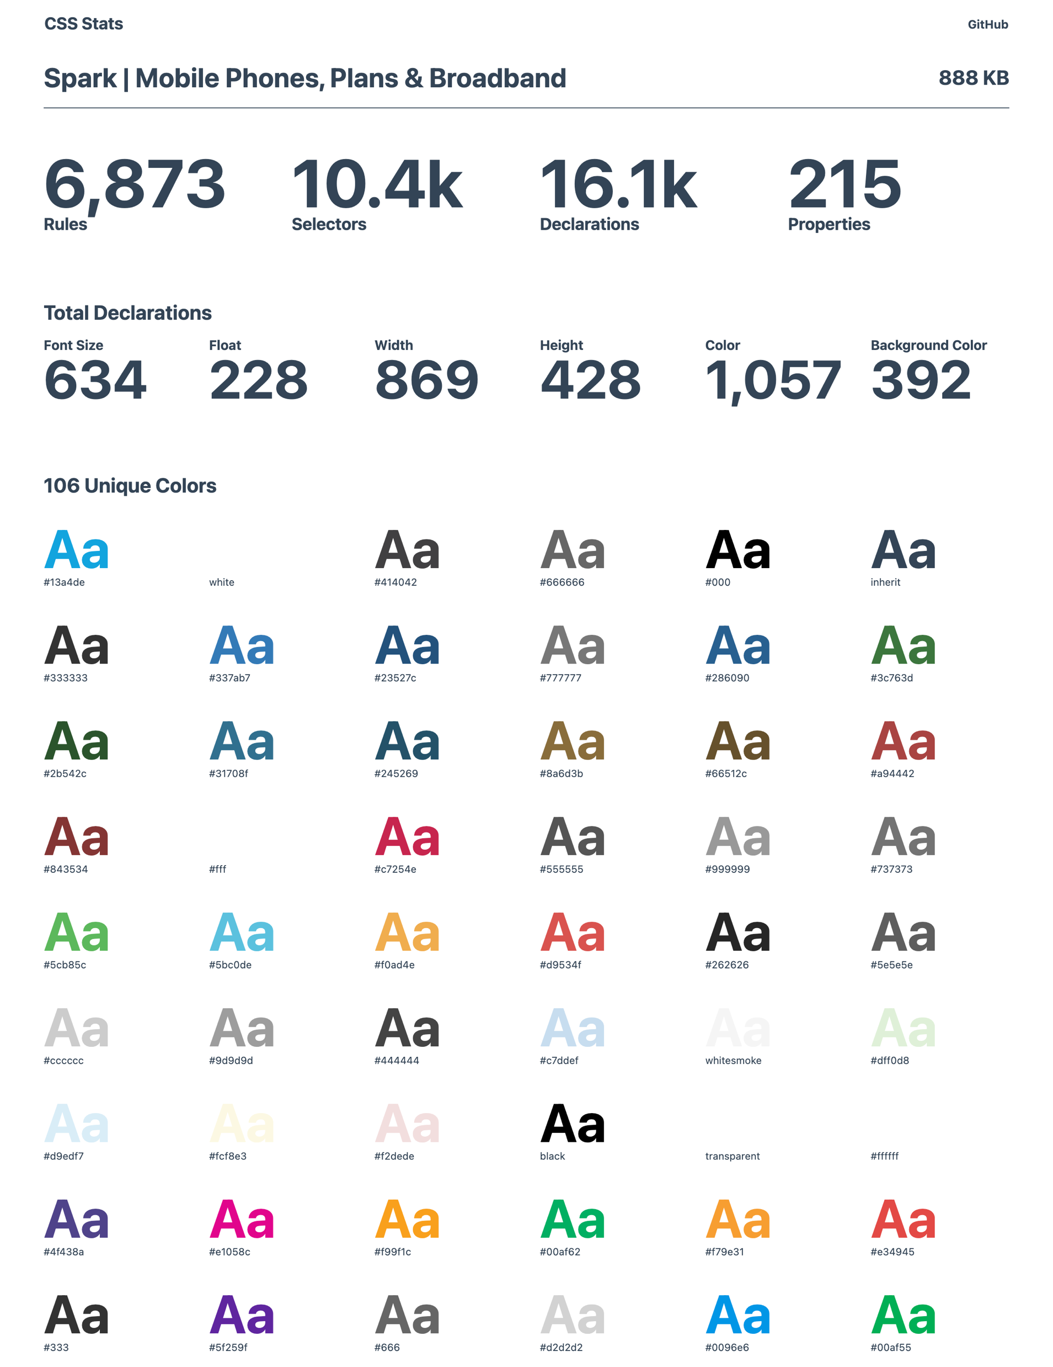
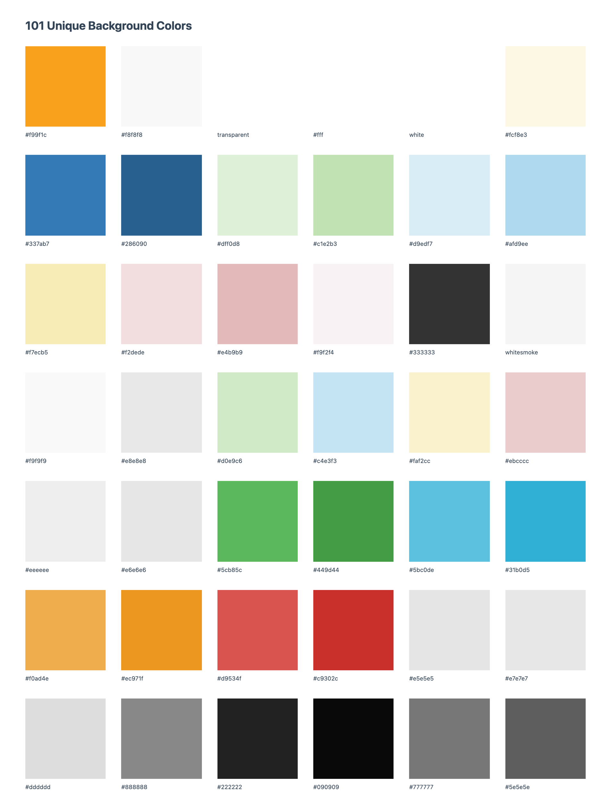
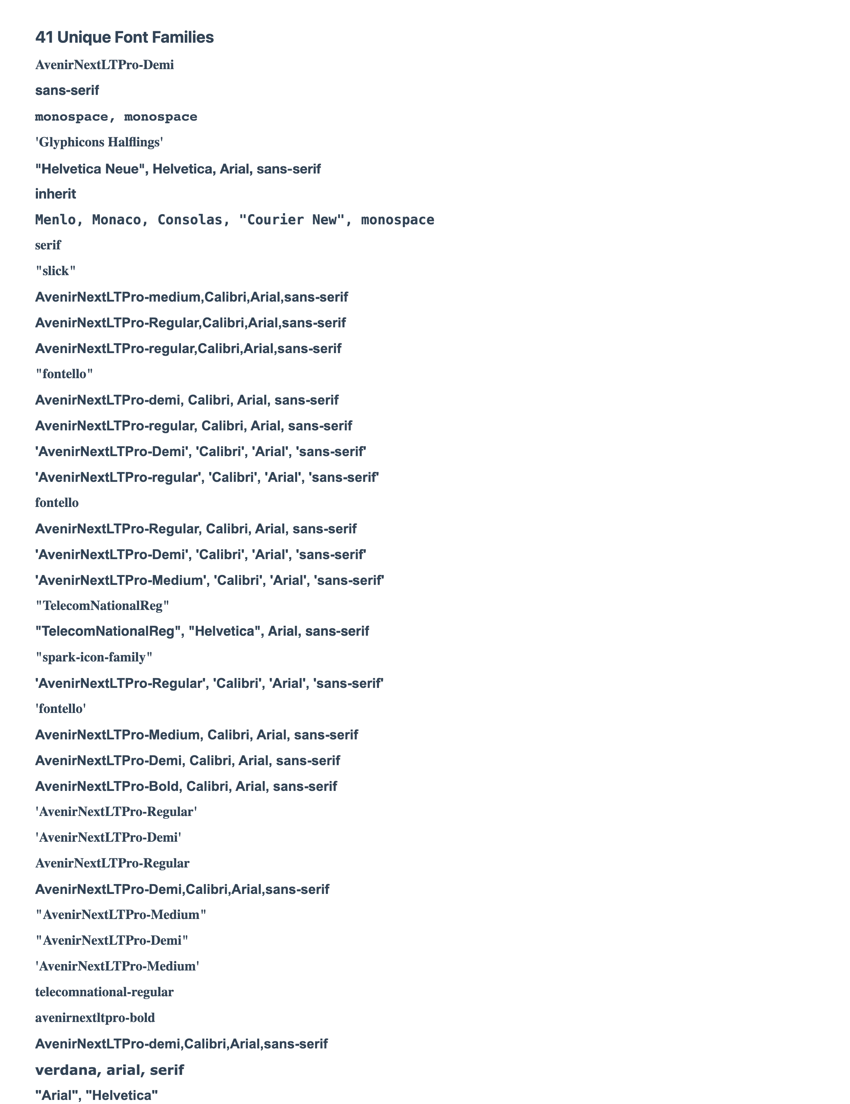
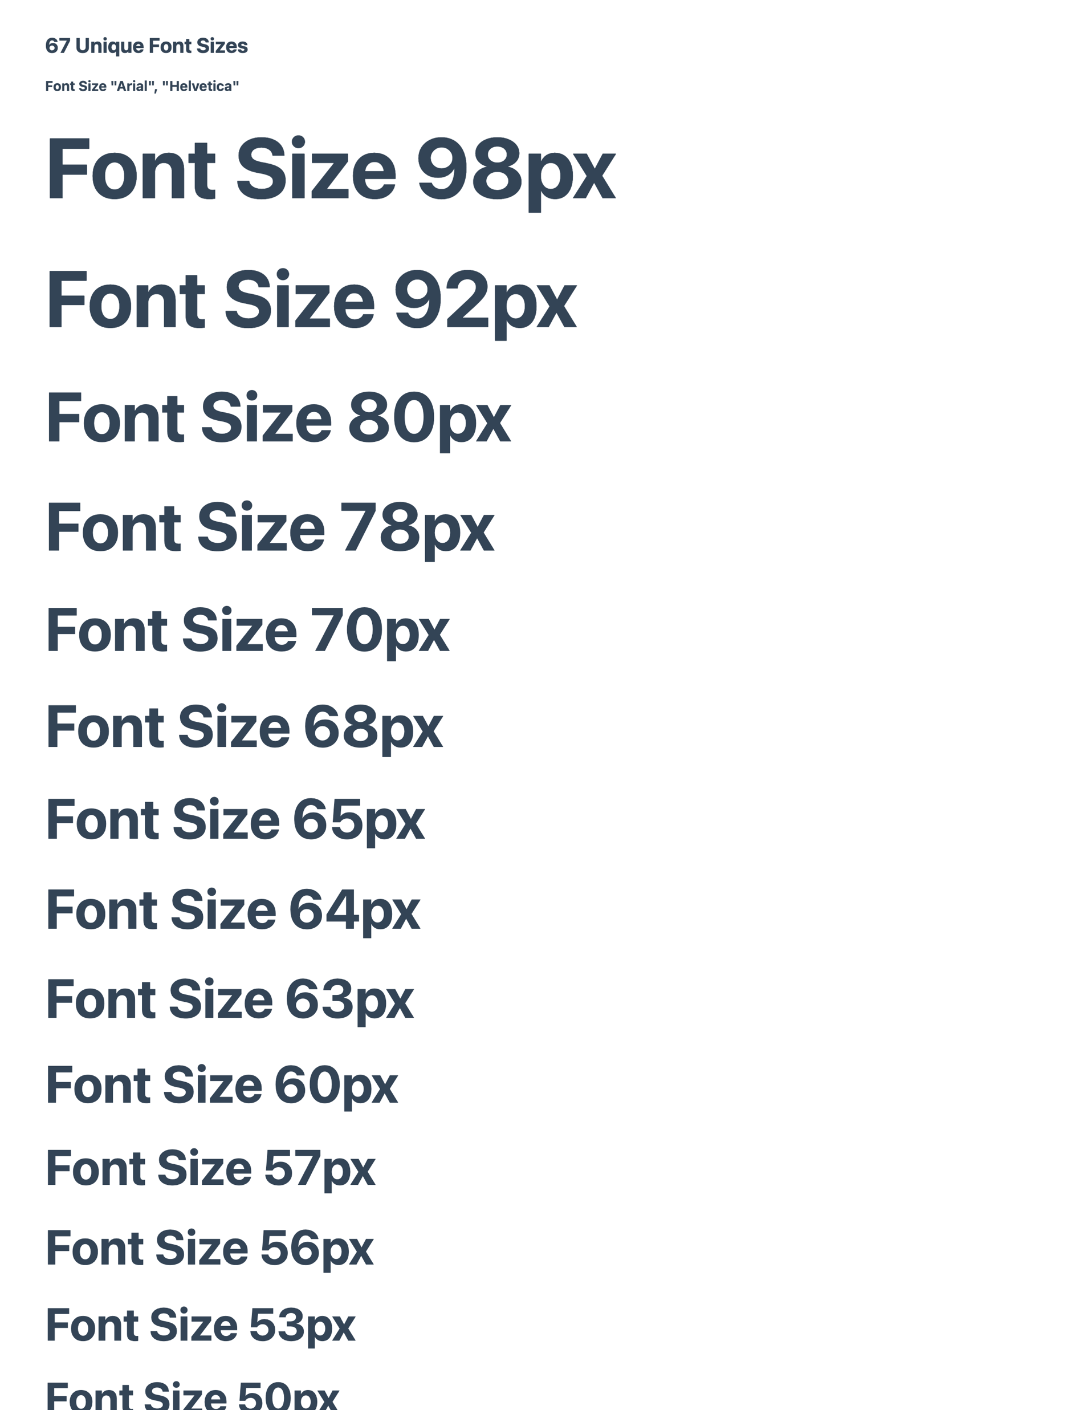
Spark
Design tokens
Solution
I audited the largest Spark website (spark.co.nz) which identified the huge volume of unique style declarations, many of which were redundant, obsolete and trivial (ROT).
Notes:
From

Slide 5
Spark
Design tokens
Unique styles
The CSS Stats report outlined the scale of the issue we had, hundreds of unique styles across all multiple files. There were multiple contributing factors, legacy code, inaccurate design specs, multiple teams with different priorities and a surprising lack of communication.
Recommendation:
Create a distilled set of styling tokens that all components would reference. New components would only use tokens and no absolute values or units (where feasible).
Legacy debt
Multiple large CSS/JS/font files were being loaded which carried large amounts of unnecessary styling. Everyone was afraid to re-use or edit existing styles so things were always being written new or as overrides with higher specificity. The !important rule was used over 700 times in the core files.
Recommendation:
Triage components based on their usage, replacing hard coded style values with tokens from the master set. Custom component styling that had little reuse would remain in the component directory.

Slide 6
Spark
Design tokens
Handover
There were issues with design handover that could have been avoided. Designers and engineers relied on Zeplin (design inspection tool) for design specs handover. Engineers were expected to follow the design specs accurately, but these often carried over small inconsistencies and mistakes from the designers. Specs were followed precisely, so they passed at QA because it matched Zeplin.
Recommendation:
Handover and build process needs to be improved, closer collaboration to identify issues earlier. If engineer unsure which token to use, first check for with design before submitting new token request to UI Chapter. We were able to use token names in Zeplin for colours and text, but limitations meant we couldn’t have multiple tokens with the same value (e.g. backgroundOrange and textOrange couldn’t have the same value).
Unpredictable styling/SASS
There were issues created when developers duplicated existing components as a base for a new one, bringing unnecessary code into each subsequent component. Some developers were already using SASS to manage variables in the component. But the same SASS variable names would be used in different ways or with very different values, there was no reuse of values between the components. This led to unpredictable design changes when we tried to apply standard tokens across multiple components.
Recommendation:
Switching to clearly named tokens encouraged more predictable usage, and made it easier to identify issues. For example not using a font size for spacing, or background colour for a text colour.

Slide 7
Spark
Design tokens
Building components
Adobe Experience Manager (AEM) is used across multiple Spark websites, but there were limited engineers who were knowledgeable in building AEM components. Teams without AEM developers would create the page content using the HTML/JS/CSS and it would then be converted for AEM.
Developers would often clone an existing component and make changes to it. They might setup a new SASS file for managing their styles, but only supply the CSS to the AEM developer. The AEM developers sometimes would convert the CSS into a SASS file before making changes and generating a CSS file again. All the ROT code was being carried forward.
Recommendation:
Establish standardised design tokens to be used across all AEM components, engineers to reference named tokens instead of hard coded units and values. Predictable named , clearly defined in Sketch and Zeplin would make engineer and QA to follow component styling and reduce inconsistencies. Designer workflow to be more thorough before handover, engineering to liaise with designers when values that do not map to existing tokens.
Outcome
I created an initial set of tokens to manage the core branding and design standards across all our components. I presented my findings and recommendations to key stakeholders including design and engineering chapter leads. The pitch was well received and the stakeholders agreed to start using the new standard token library in new development. Reworking the legacy components was unfortunately not a priority.
I worked with a couple of the React and AEM developers to refine the token naming, documented the workflow and determined how best to distribute the tokens. The tokens and updates to the handover process was presented to designers and engineers, inviting their feedback and encouraging participation in growing the library. Token names and styles were synced to Sketch and Zeplin so that developers could easily identify when inspecting designs.

Slide 8
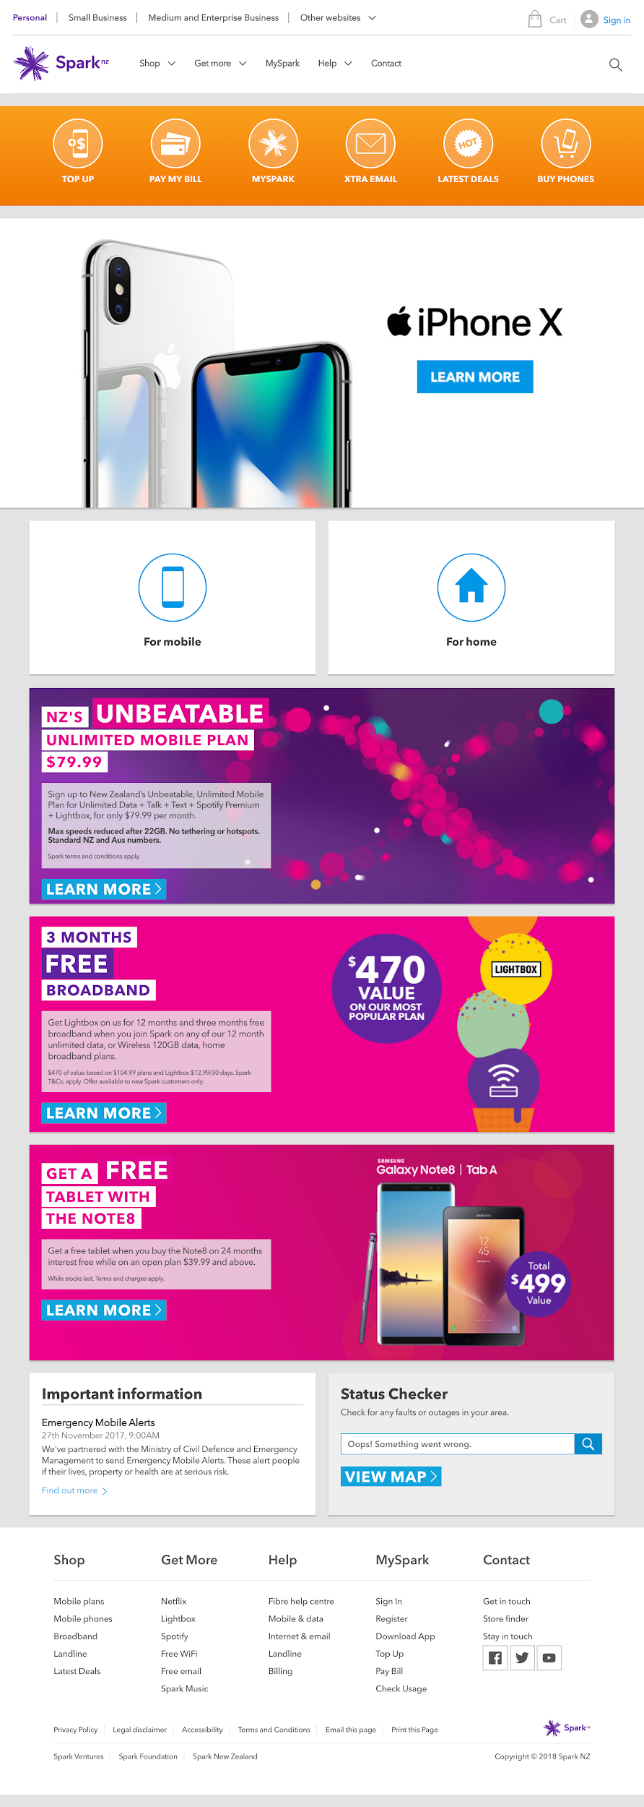
Spark
Personalised homepage
Background
The Spark homepage had become a dumping ground,
with multiple stacked promotions and enormous self-service buttons.
The hero promotion often overran the fold and self-service links pushed the marketing banners further out of view.
It was image-heavy, slow to load and engagement was poor below the fold.
Problem
We had to redefine what we wanted the homepage to be, instead of a series of banners cascading down the screen.
We wanted to make the homepage more engaging for visitors, whether they were browsing or had an account. Our goal was to present more relevant information to them, to help them find the content they wanted more easily.

Slide 9
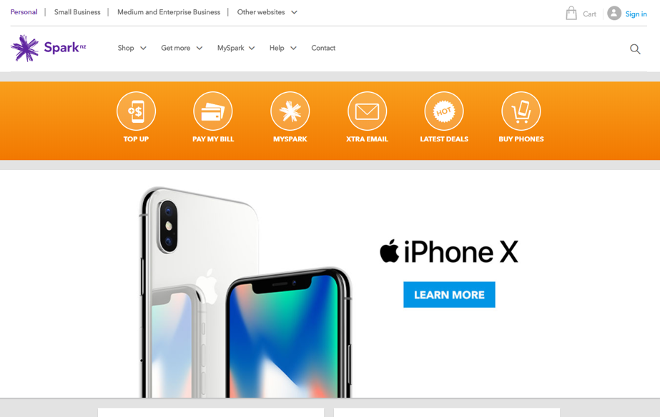
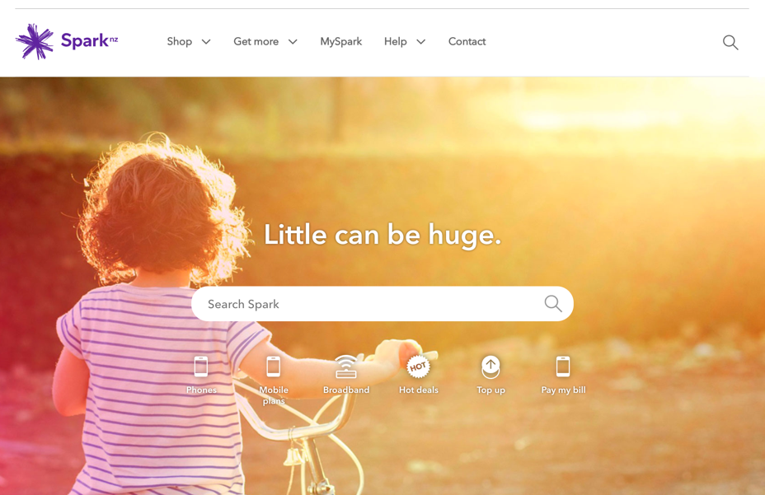
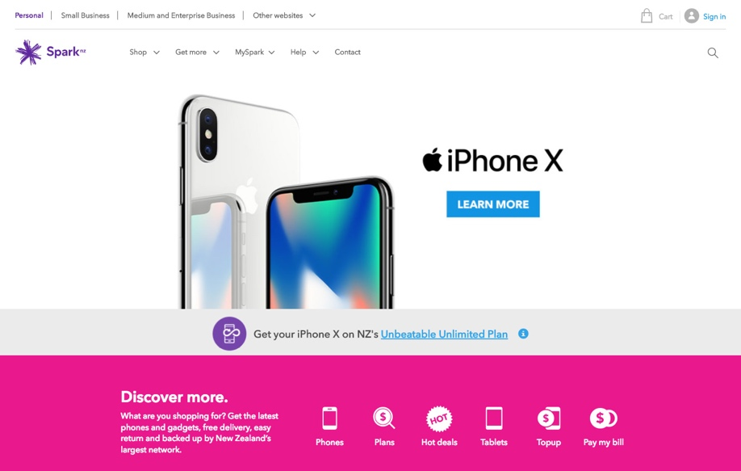
Spark
Personalised homepage
Solution
We analysed the common actions on the homepage based on what we could determine about the visitor. Adobe marketing automation allowed us to segment visitors and present targeted content and more relevant quick links.
For prospective customers we could push broadband and phone offers instead of top-ups and upgrades.
Existing fibre customers shouldn’t have to see promotions for fibre. Depending on their billing cycle we could promote relevant quicklinks like ‘Pay a bill’ if bill is due, or ‘Top up’ when their account credit is low.
We created two distinct concepts incorporating this new personalisation and ran split testing on 10% of the homepage traffic for several weeks to monitor how they performed against the existing homepage.
I designed Concept A to be user-centric, promoting search and quicklinks over marketing banners. Another designer worked on Concept B, which refocused the page on a personalised product banner spot.
ORIGINAL
CONCEPT A
CONCEPT B

Slide 10

Spark
Personalised homepage
Outcome
In both tested versions, there was a decrease in average time on page by 10 seconds and customers were 25% less likely to quit the site once landed on the homepage. There was also an improvement in the amount of traffic going to the plans and pricing pages for Mobile and Broadband.
Concept A performed stronger across more metrics and we launched it as the new homepage. The squad continued to iterate and optimise personalisation. Metrics included:
Click-through rate to
device gallery page
increased by 50%
Sales conversion
increased by 79%
Click-through rate to
device details pages
increased by 53%
Page engagement
increased by 9.2%
CONCEPT A

Slide 11
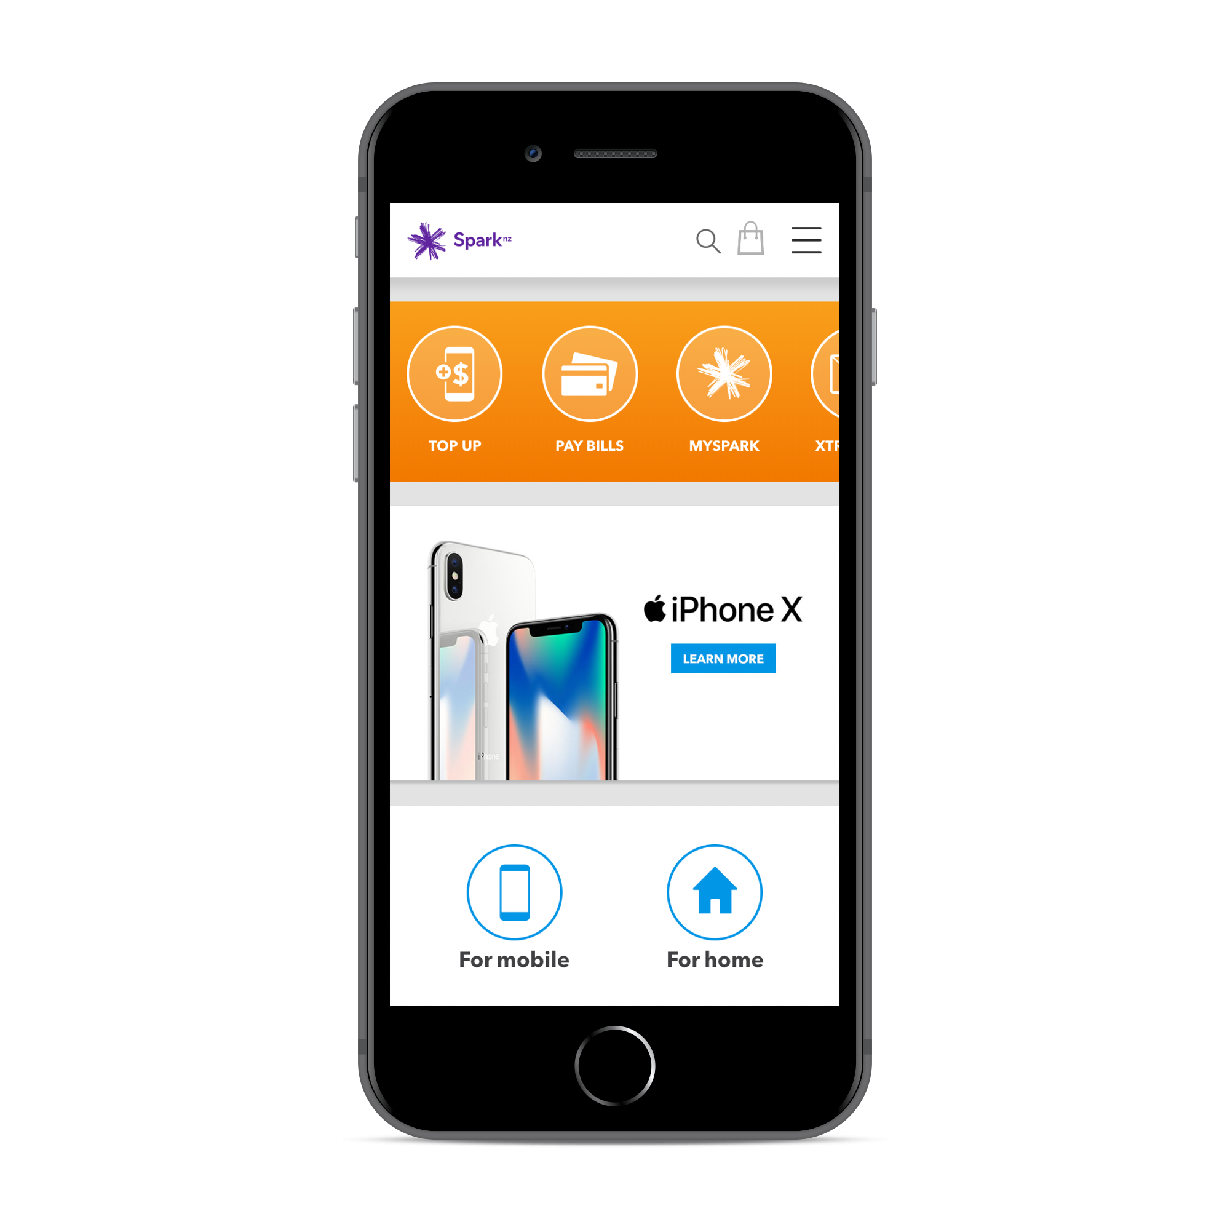
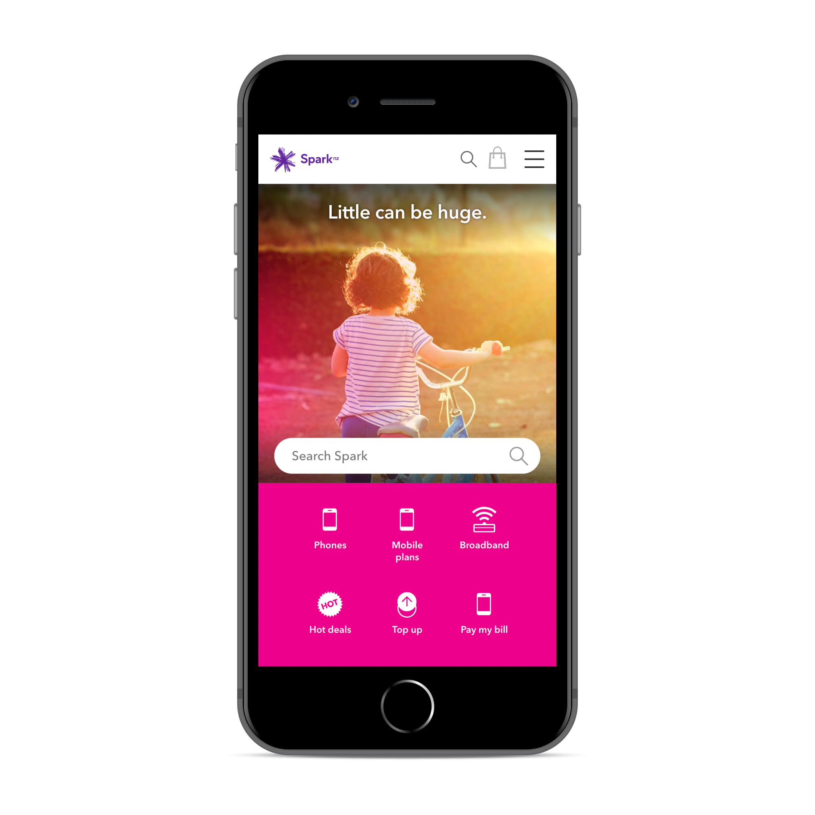
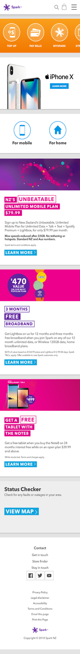
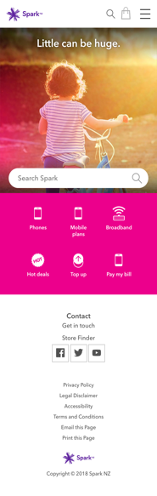

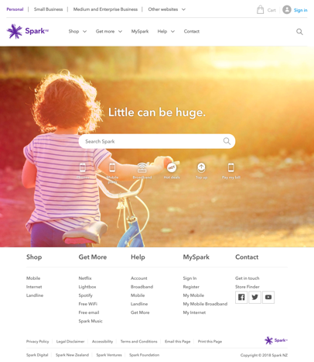
Spark
Personalised homepage
Mobile full-height
Desktop full-height
ORIGINAL
CONCEPT A

Slide 12
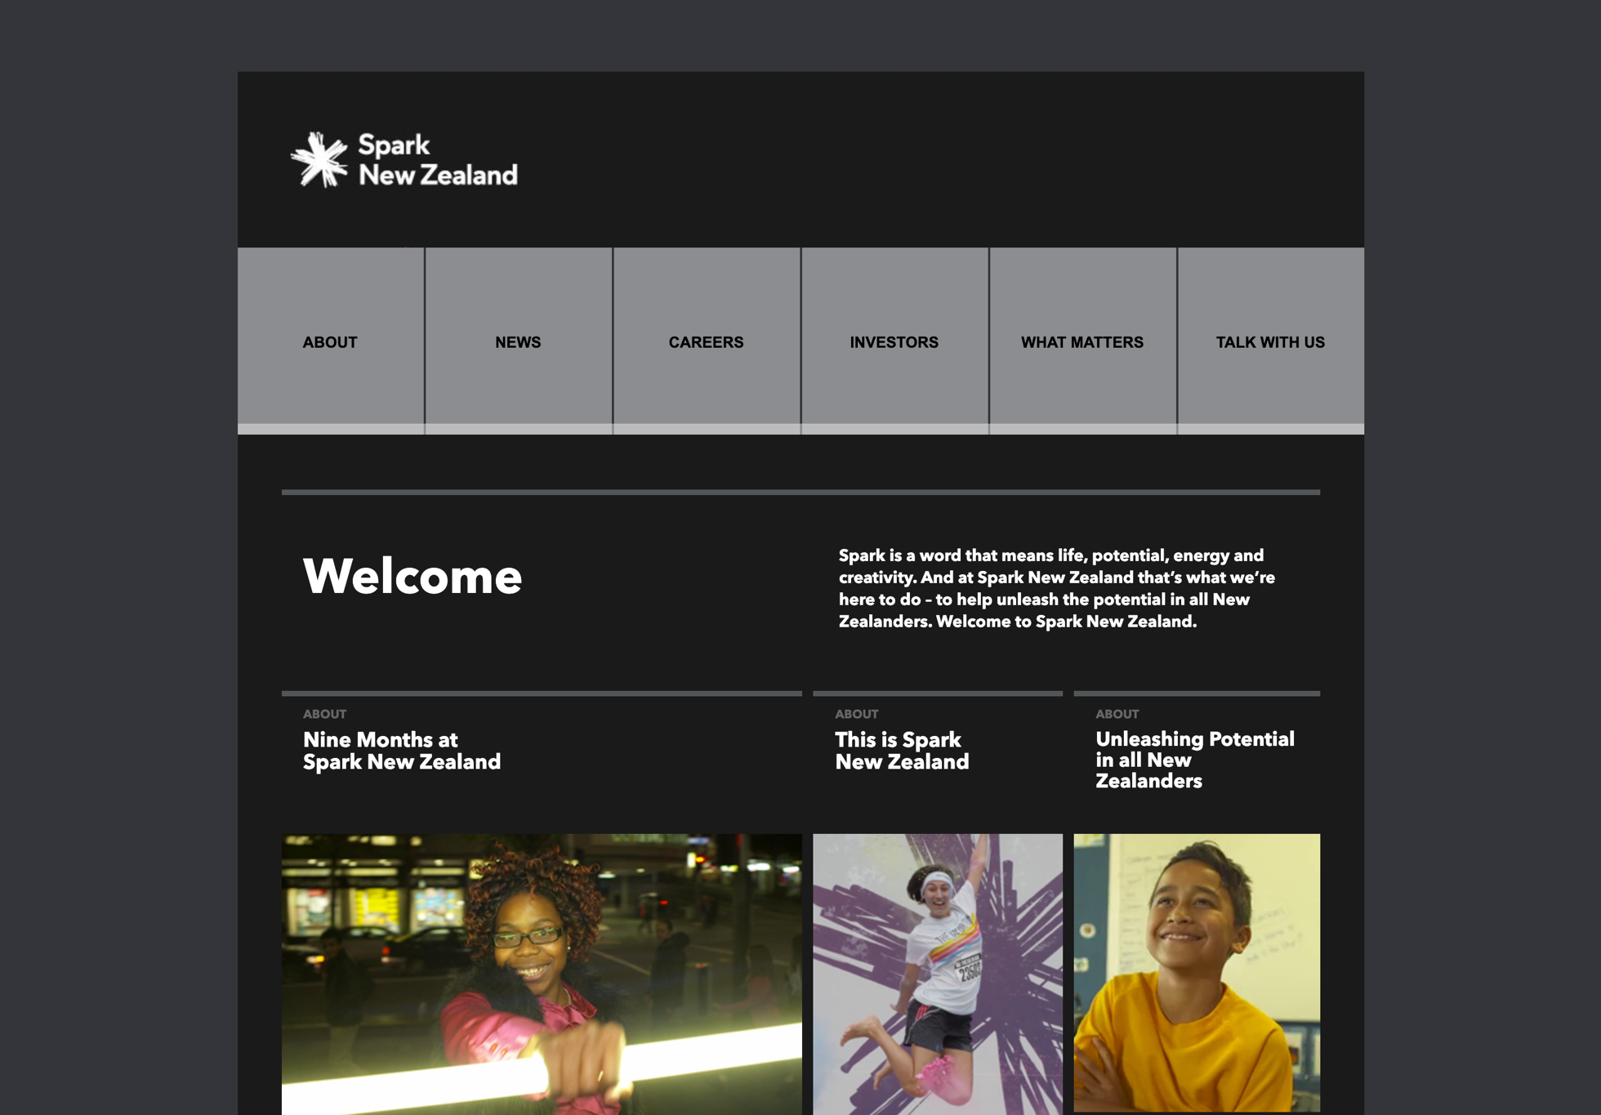
Spark Corporate
Website refresh
Background
The project goal was to re-platform and redesign the outdated Spark corporate website. We had already rolled out the Spark Experience Toolkit (SET) design system across our larger websites (consumer and business).
Problem
The sparknz.co.nz website and microsites (Careers, Investor Centre) hadn’t been updated in over 3 years.
We wanted to bring the site onto the same Adobe Experience Manager (AEM) version as core sites and align all the pages to the SET design system.
The site had been built using custom HTML instead of any common components, which was problematic for easily identifying the content.
The budget was going to be tight and it was a considerable amount of work for a short timeframe.
ORIGINAL

Slide 13
Spark Corporate
Website refresh
Solution
Audit and redesign the whole site to reduce the number of unique page templates and custom HTML. By restricting ourselves to the existing components in SET, we reduced the development effort required.
I led the design process, coordinating with engineering and stakeholders in corporate comms. I used automation tools to create a complete site map and generated full-page screenshots of the entire website.
We manually audited every page to identify the custom content, clustered them into suitable page templates and assigned components. Because of the close collaboration with engineering leads, we were able to create many pages with simple conversion instructions, identifying the appropriate template and AEM components to use for each section.

Slide 14
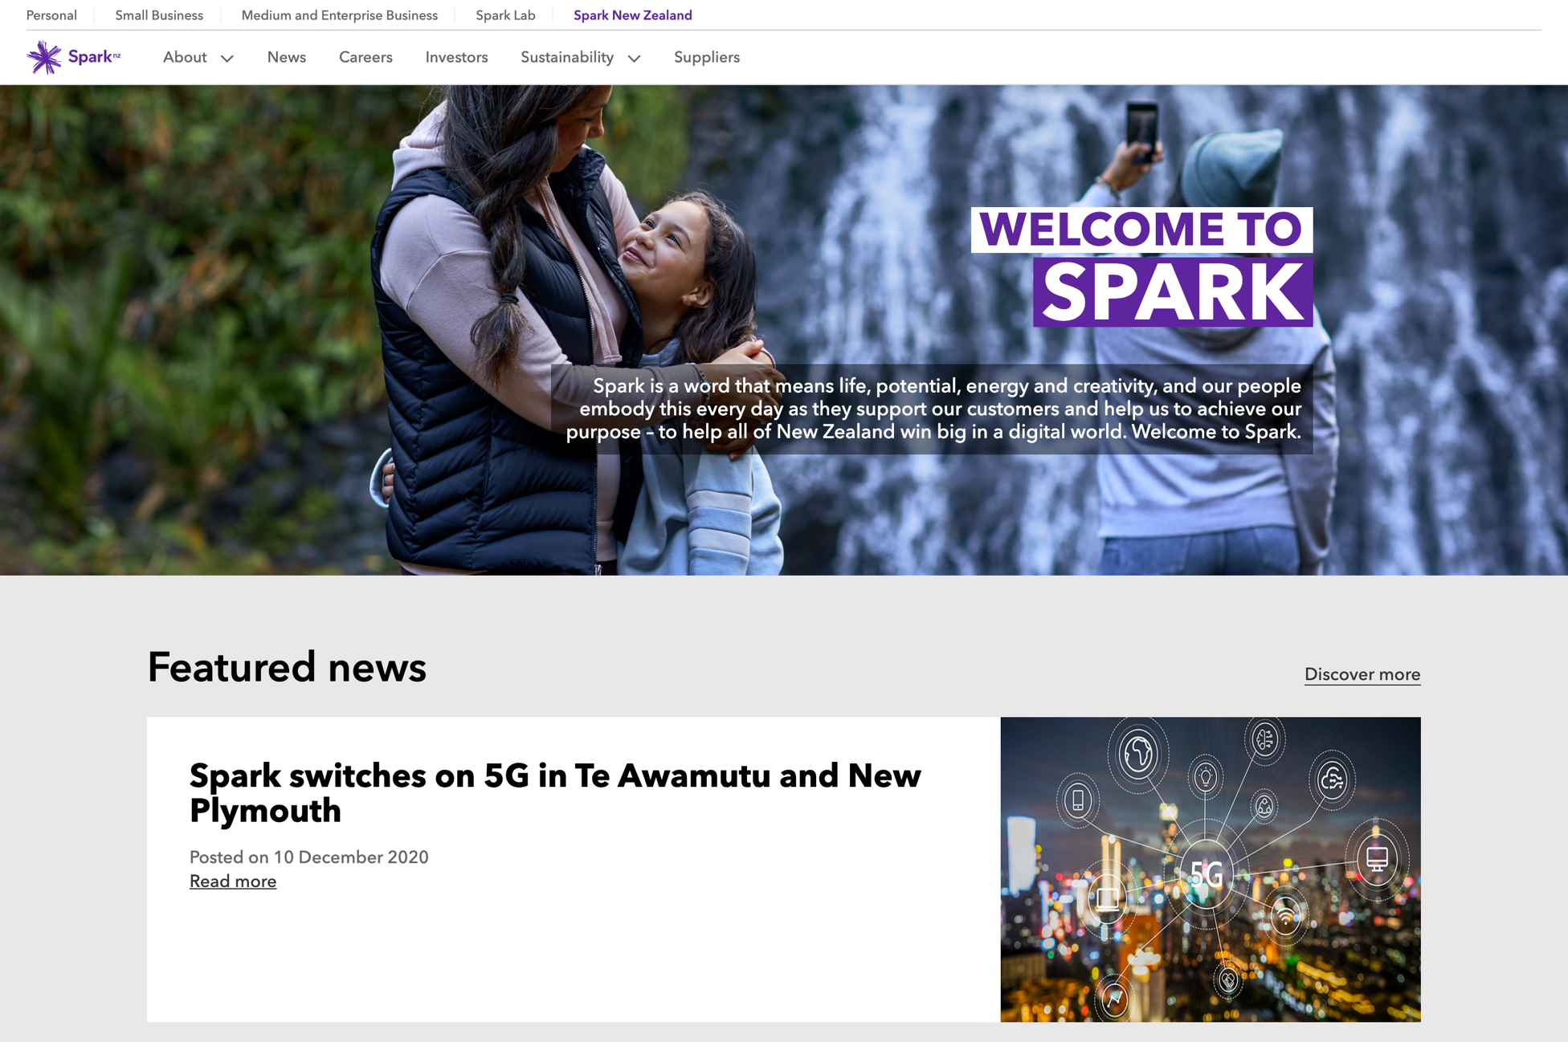
Spark Corporate
Website refresh
Outcome
We successfully relaunched the site using only the new components from SET. The AEM upgrade was a big improvement for managing content on the site.
Challenging the designers to limit the designs to use only available components was critical to the fast turnaround time required.
We were also able to update the third-party microsites (Career, Investor Centre) with targeted style overrides.
UPDATED

Slide 15
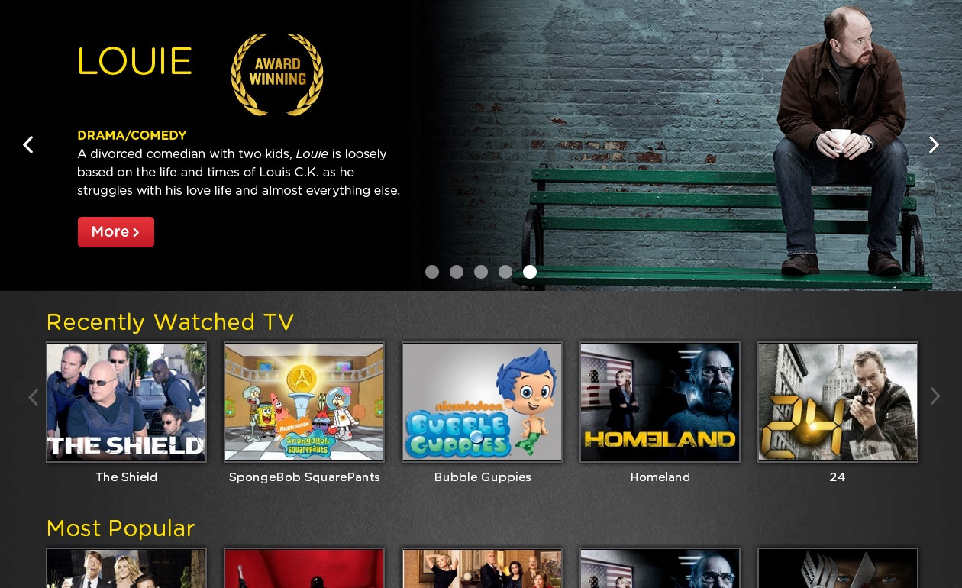
Lightbox
Dynamic carousels
Background
I observed how the Lightbox marketing team were briefing in more and more ad hoc static banners for every new show and episodic release. These carousels were on all the platforms and because the ratios and banner content were all unique, each request meant a designer had to produce five variants of the same banner.
Problem
If text needed to be updated, or a show won an award,
five images needed to be edited and resupplied.
Images all needed to be compressed, which meant text quality was impacted to keep file size down.
Each carousel slide could only have a single call to action. They could only link to the show page, ‘More’.
If the viewport size changed (web/mobile), the image and text scaled up and down, impacting legibility.
Screen readers and search engine crawlers can’t interpret text in an image.
STATIC

Slide 16
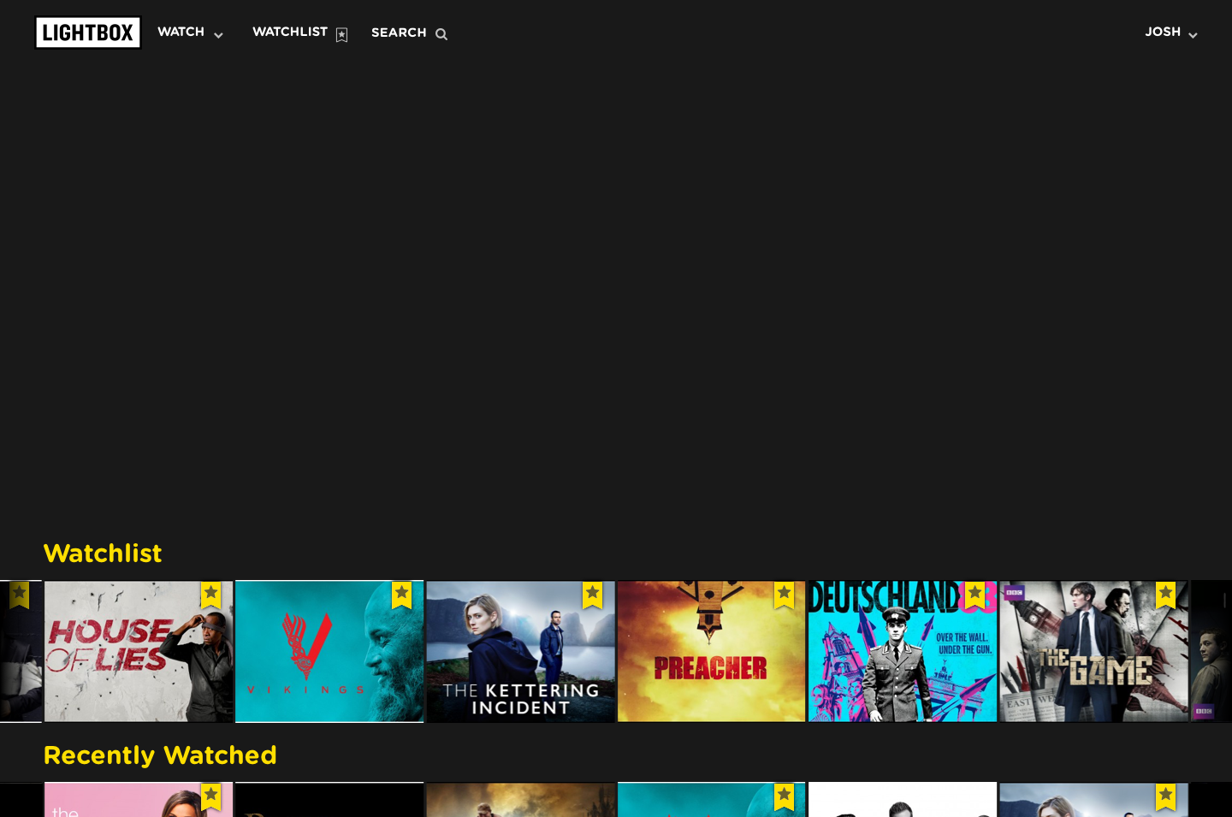
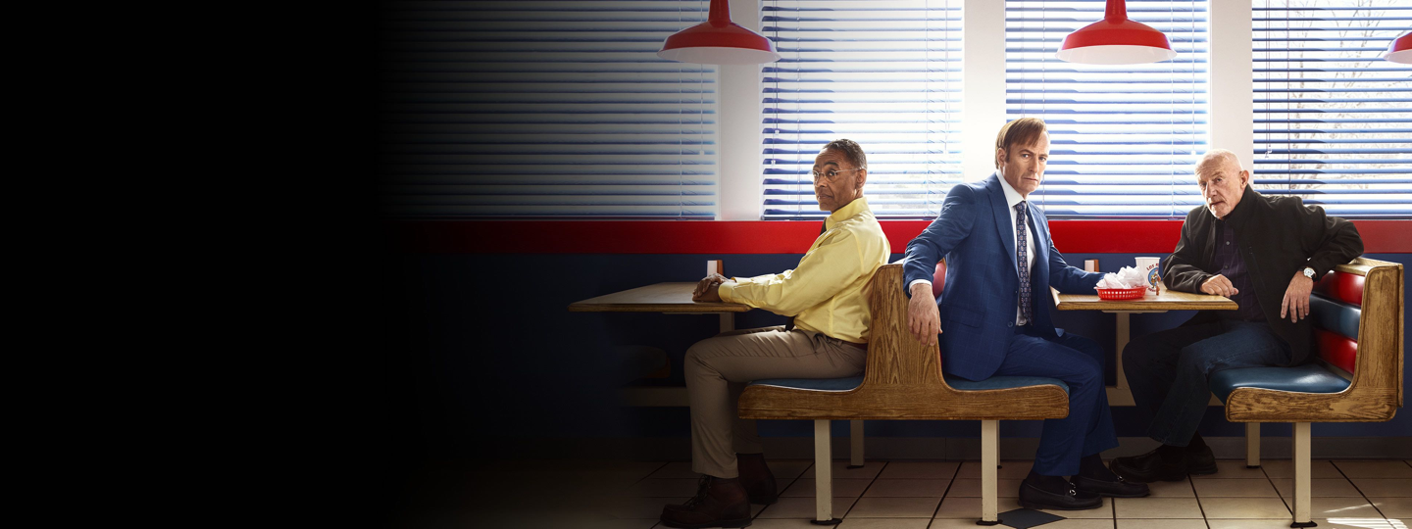


Lightbox
Dynamic carousels
Solution
I designed a flexible template that allowed the marketing team to create and edit the banner content in the Lightbox CMS.
By standardising the banner ratios across the apps, I reduced the variations required across platforms. This meant fewer images required across all platforms.
Because the images no longer included any text, designers could process each request much more quickly.
This simplification let the marketing team manage carousels more efficiently. They could make changes easily, often without needing a designer.
DYNAMIC

Slide 17
Lightbox
Dynamic carousels
Outcome
Switching to content-editable banners was a game-changer for the content team.
Content team can quickly create and update carousels using the CMS.
Reduced dependency (and spend) on visual designer time.
Easily create slides for high-frequency content, e.g. episodic releases.
Add metadata and multiple calls to action on the banners, e.g. ‘Watch now’, ‘More info’, ‘Save to my watchlist’ and genre links.
Text and image elements can be individually animated. I introduced subtle intro/outro motion effects.
Notes:
Duplicate slide for animation purposes

Slide 18
Lightbox
Dynamic carousels
CTA
Outcome
Switching to content-editable banners was a game-changer for the content team.
Content team can quickly create and update carousels using the CMS.
Reduced dependency (and spend) on visual designer time.
Easily create slides for high-frequency content, e.g. episodic releases.
Add metadata and multiple calls to action on the banners, e.g. ‘Watch now’, ‘More info’, ‘Save to my watchlist’ and genre links.
Text and image elements can be individually animated. I introduced subtle intro/outro motion effects.
Copy
Image
Homepage

Slide 19
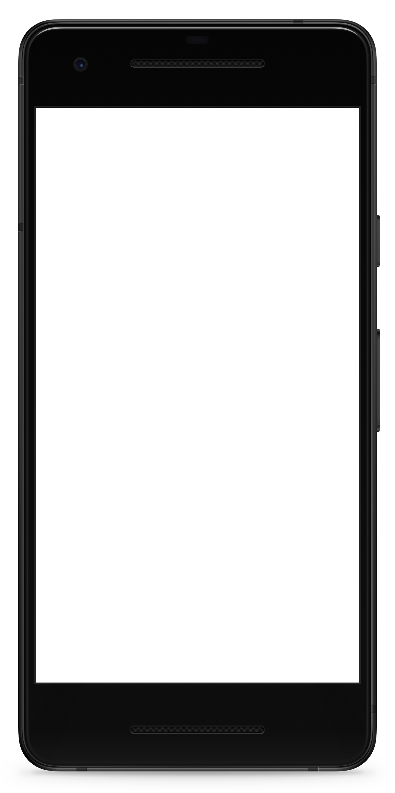

Spark
Carrier branding
Background
Early morning or late at night, whenever I would turn on my phone, the screen would play a clunky Spark logo animation. The screen was always 100% brightness at start-up, and the Spark logo quickly flashed through all four brand colours. It was so bright it would light up the room.
Problem
I knew I could improve this overlooked flash of branding and decided to kickstart the work myself.
I researched on several tech and gadget forums and found that poor carrier-branding was a real point of frustration.
ORIGINAL

Slide 20
Spark
Carrier branding
Solution
I researched how carrier branding was generated and deployed across handsets, the process to create a new package seemed straightforward, getting it onto phones was going to be the challenge.
I reached out to several internal teams until I connected with the New Product Introduction Manager. They were all-in from the start. They could update the devices if I could provide the animation package and get approval from the brand team to roll it out.
I mocked up a concept for a much more subdued boot animation on a black background and pitched it to the Head of Brand and Marketing.
ORIGINAL

Slide 21


Spark
Carrier branding
REFRESH
Outcome
The pitch was a success, and the new branding was approved to roll out on upcoming Android devices, just in time to get it preloaded for the launch of the Samsung S9.
It has been rolled out on a wide range of new devices over the years and even loaded onto the Spark Kids smartwatches.
My favourite feedback about this project came indirectly in one of the forums (Geekzone). Among the discussion for the launch of the Samsung S9 I found this:
  “Not a fan of carrier customisations, but will say the Spark boot animation is nowhere near as obnoxious as on previous models - white logo on black background.
  A lot more subtle than the blinding mess it used to be.”
Couldn’t have hoped for more honest feedback. It’s a minor change, but it felt so good to improve that terrible experience.
NEW

Slide 22
MATTR
Design Process, UI Kit & Tokens
Content coming soon.
Note: Due to NDA there will be limitations on
how much of this project I can include.

